Slide 1

Corridor Charging Infrastructure: Accessibility and Redundancy
Aaron Rabinowitz, Vaishnavi Karanam
5/16/2024

Slide 2
Transportation Accessibility
Definition
The purpose of infrastructure is to provide access for people to opportunities
Transportation Accessibility:
“The ease with which individuals can access opportunities subject to the transportation system in the relevant area”
Transportation Accessibility definitions differ on the following points:
What opportunities to consider?
What transportation options to consider?
What area to consider?

Slide 3
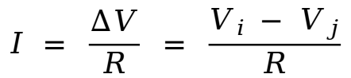
Transportation Accessibility
Circuit Analogy
“The ease with which individuals can access opportunities subject to the transportation system in the relevant area”
Pull Factors
Push factors
Aggregate population movement
$$I = \frac{∆V}{R} = \frac{V_{i }− V_{j}}{R}$$
Traversal difficulty

Slide 4

Transportation Accessibility
Circuit Analogy
“The ease with which individuals can access opportunities subject to the transportation system in the relevant area”
Land-use / personal preference
Pull factors
Push factors
Aggregate population movement
$$I = \frac{∆V}{R} = \frac{V_{i }− V_{j}}{R}$$
Observed traffic
Transportation system
Traversal difficulty

Slide 5
Transportation Accessibility
Methodology
The main subject of debate is how to select opportunities. There are several approaches:
Nearest Proximity: Pick the closest opportunity.
Isocost: Pick all opportunities in an isocost polygon
Gravity/Entropy: Weigh all opportunities by mutual similarity
Discrete Choice: Fit a model to observed behavior
The resistance component is universal - shortest paths
Shortest paths computed for each mode considered
Sufficiently different cars should be considered as different modes

Slide 6
Road-Trip Accessibility
Background
Modern BEVs have the range to be interchangeable with ICEVs for routine use
With reliable long-dwell charging they can even offer convenience and cost benefits
However, for long road-trips, modern BEVs still lag behind. This is because BEVs have:
Lower maximum ranges
Lower range-addition rates
Less mature supply infrastructure
The longer the trip the more disadvantaged the BEV is. This hinders goals like:
Single ICEV dependence to single BEV dependence
Mixed household fleets to BEV only household fleets

Slide 7

Road-Trip Accessibility
Background
Road-Trip Accessibility: “The ease with which all important locations within a region can be reached by a given individual using a given road-vehicle”
Land-use: how big is the region and how spread-out are its population centers?
Transportation: Layout of roads and distribution of supply stations
Individual: What are the capabilities of cars driven and how risk tolerant are drivers?
Temporal: Traffic patterns and seasonal infrastructure
A_{rt} - regional road-trip accessibility
N - number of locations
W -weights for locations (all 1 here)
C - cost (time) for traversal of O/D arc (i, j)

Slide 8
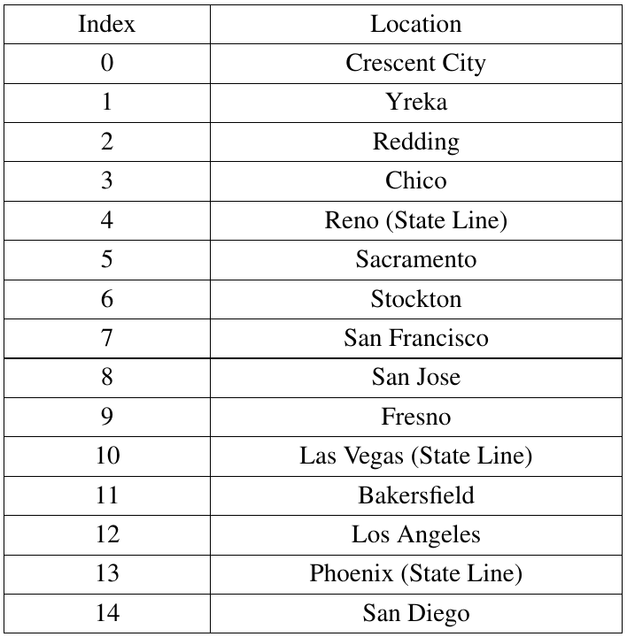
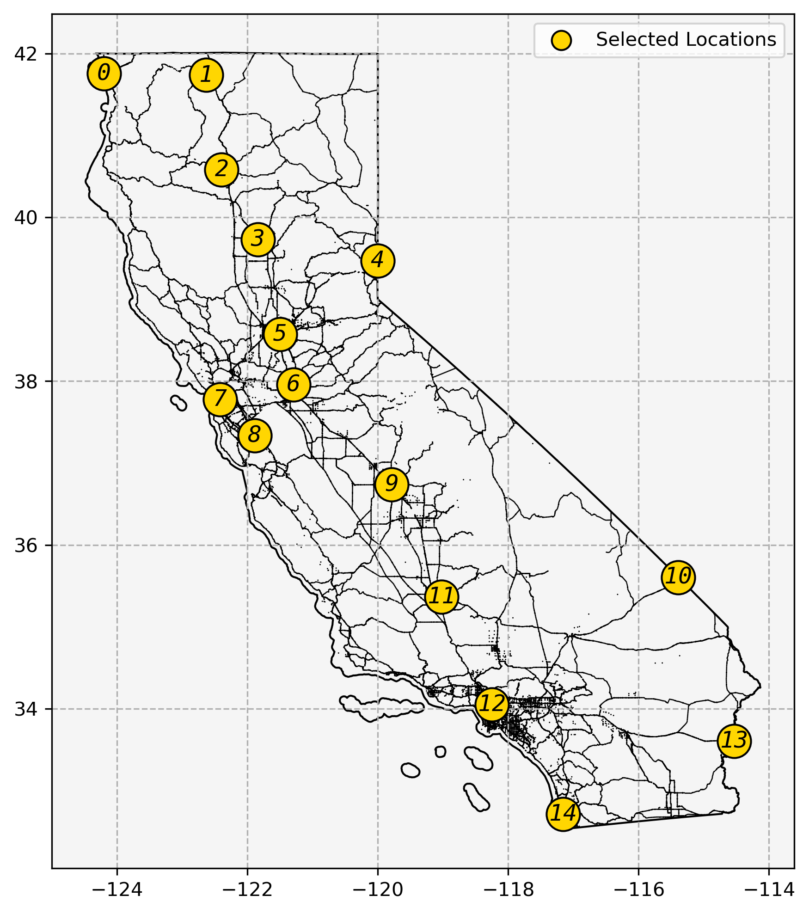
California’s Regional Land-Use
For purposes of evaluation, the following 15 locations were selected as origins/destinations:

Slide 9
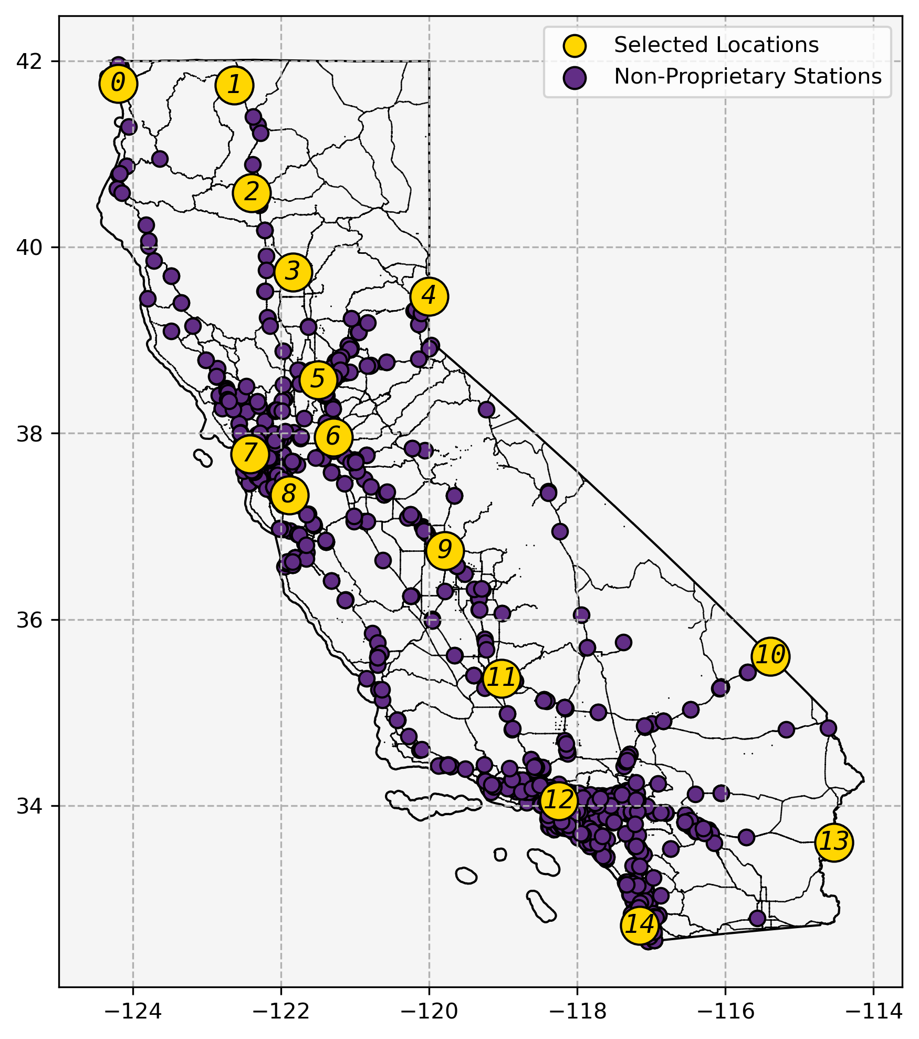
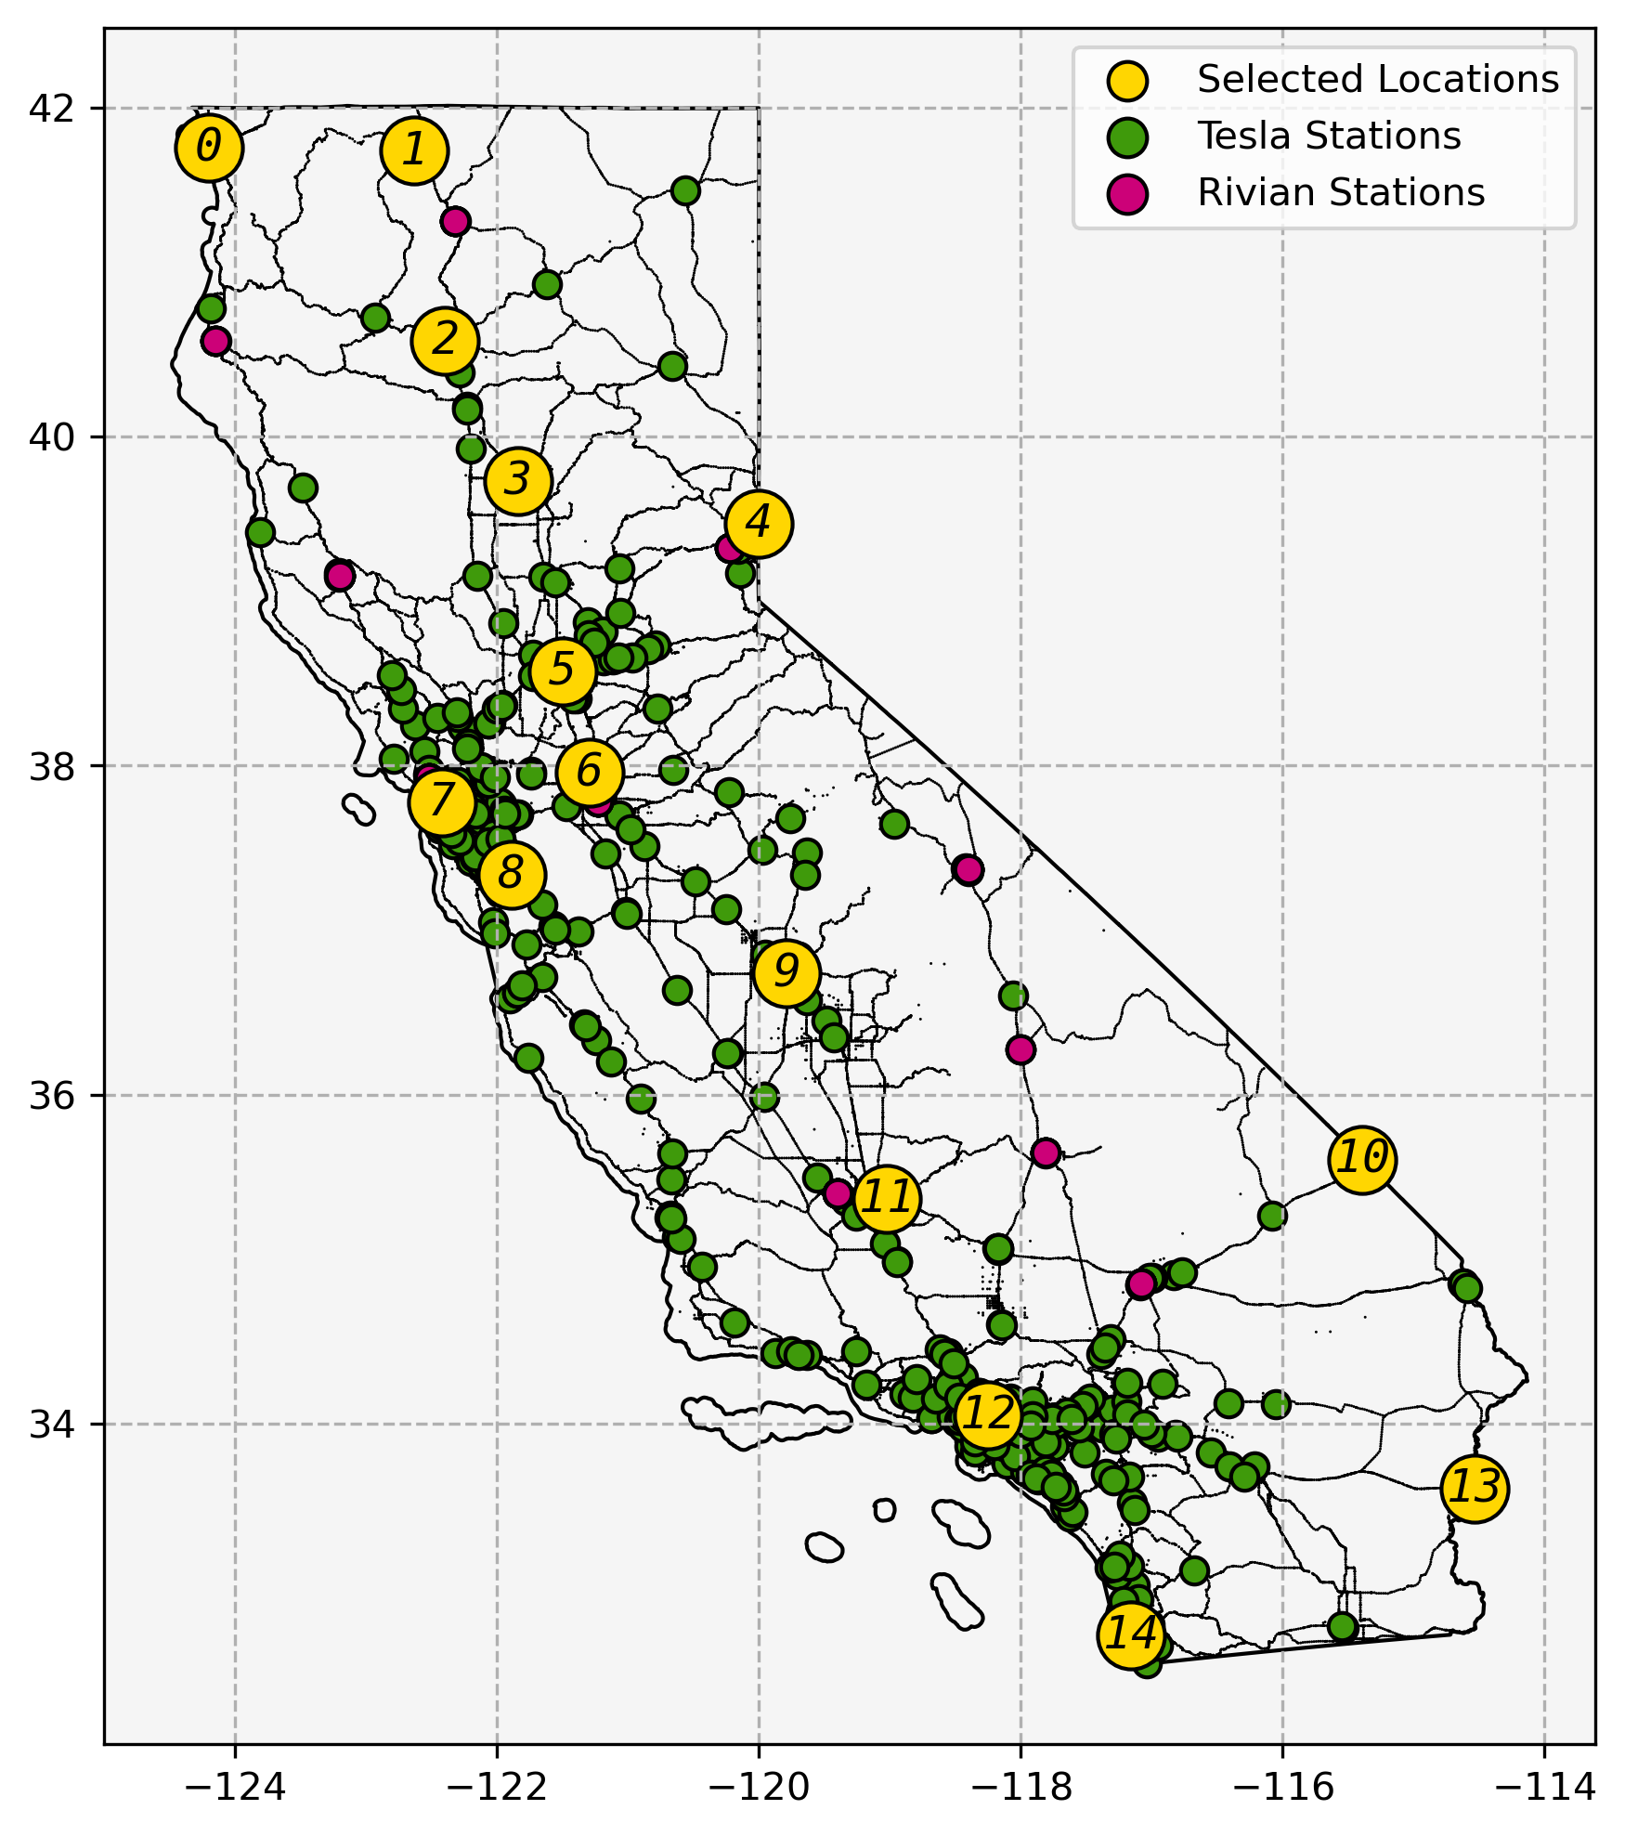
California’s DC Charger Networks
Station Locations
California contains 10+ Non-Proprietary and 2 Proprietary Networks combining for ~2,000 DCFC stations
California also contains ~8,000 gas stations

Slide 10
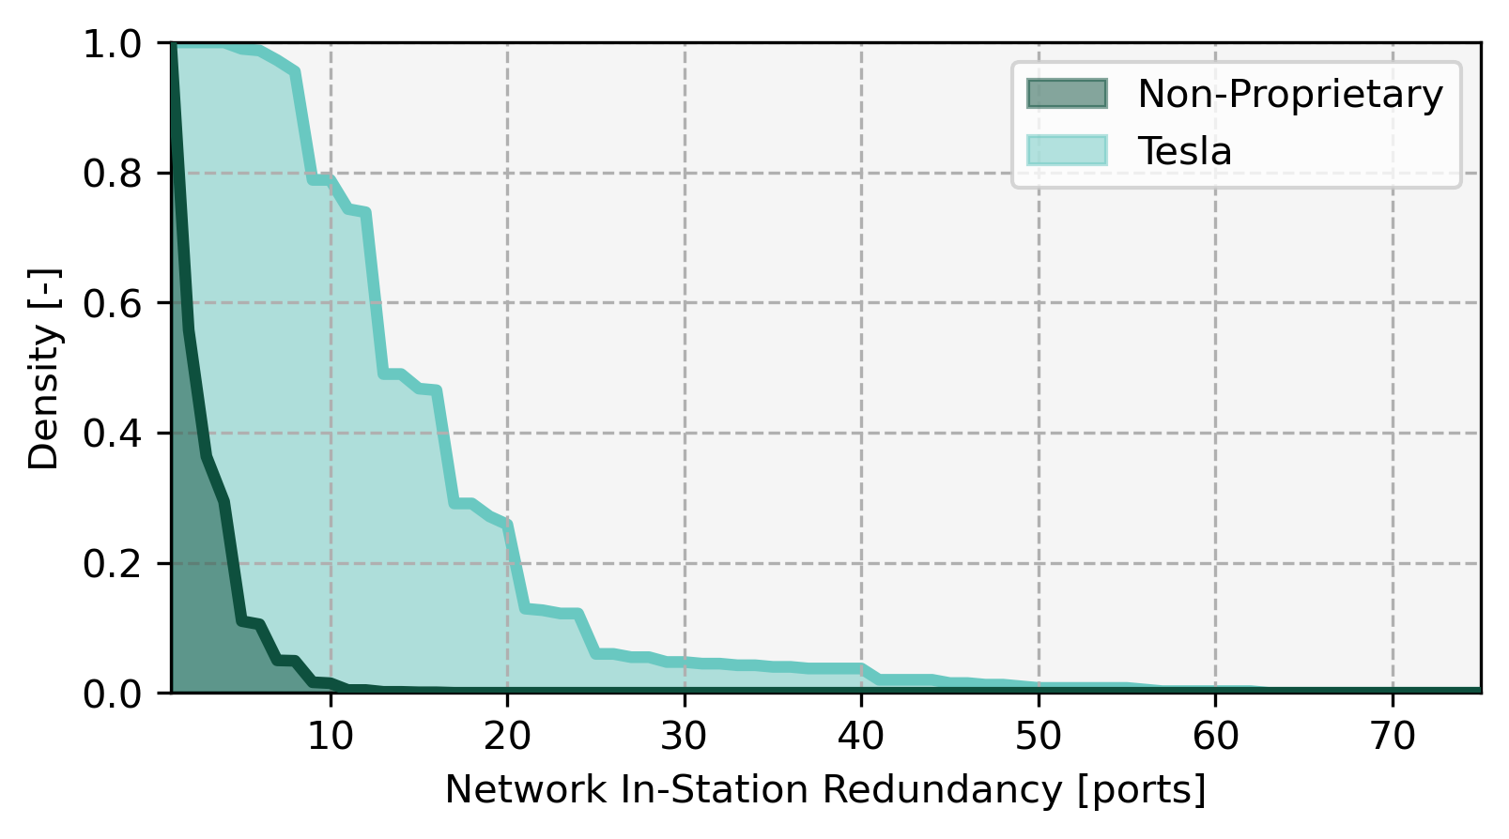
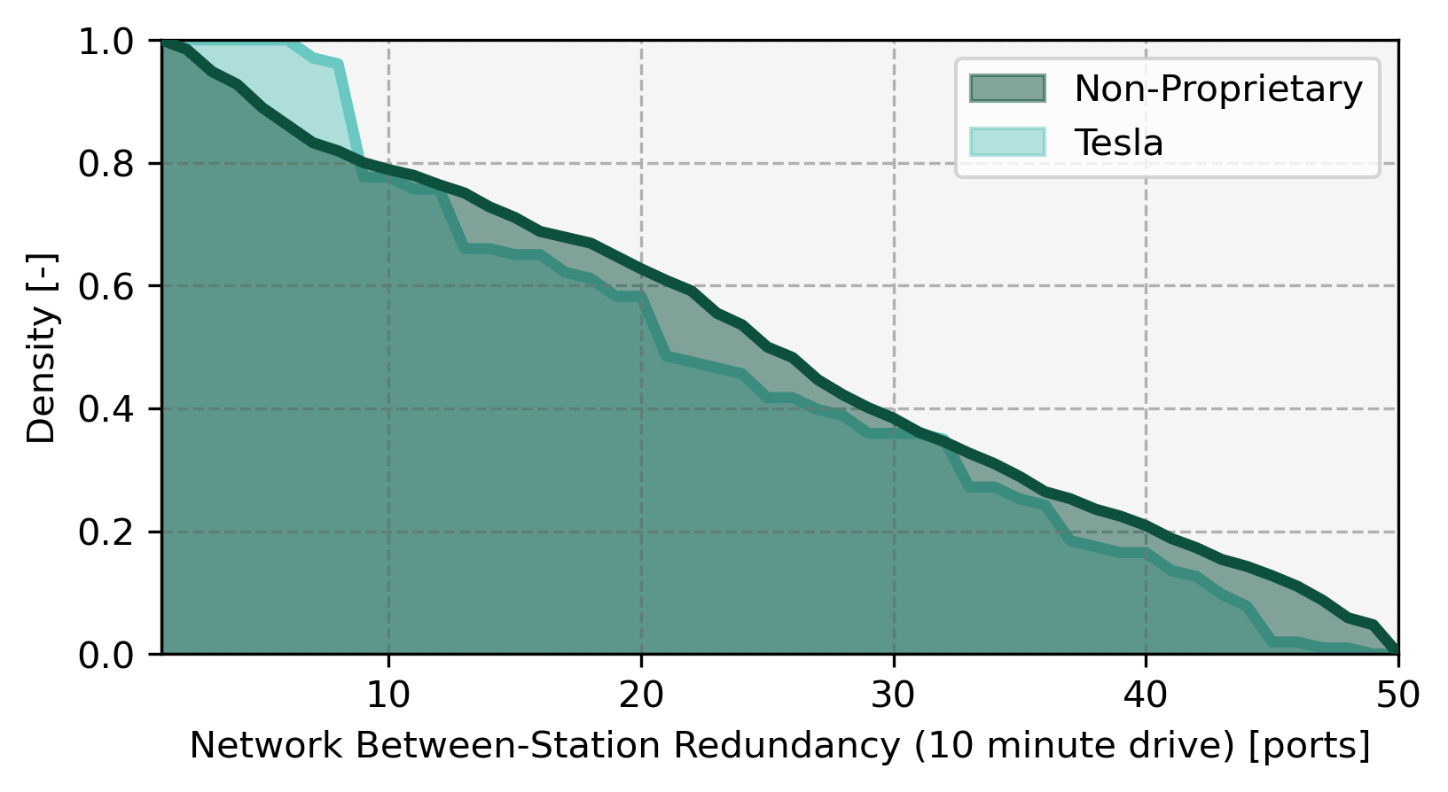
California’s DC Charger Networks
Redundancy
The purpose of charger networks is to provide redundancy
Roughly speaking, California’s DCFC stations can be divided into Tesla and Non-Tesla networks
These are largely separate and unequal networks which lead to unequal experiences because they have different levels of and approaches to redundancy
Tesla has 6,277 chargers concentrated in 403 stations
Non-proprietary networks have 3,667 chargers spread among 1,425

Slide 11
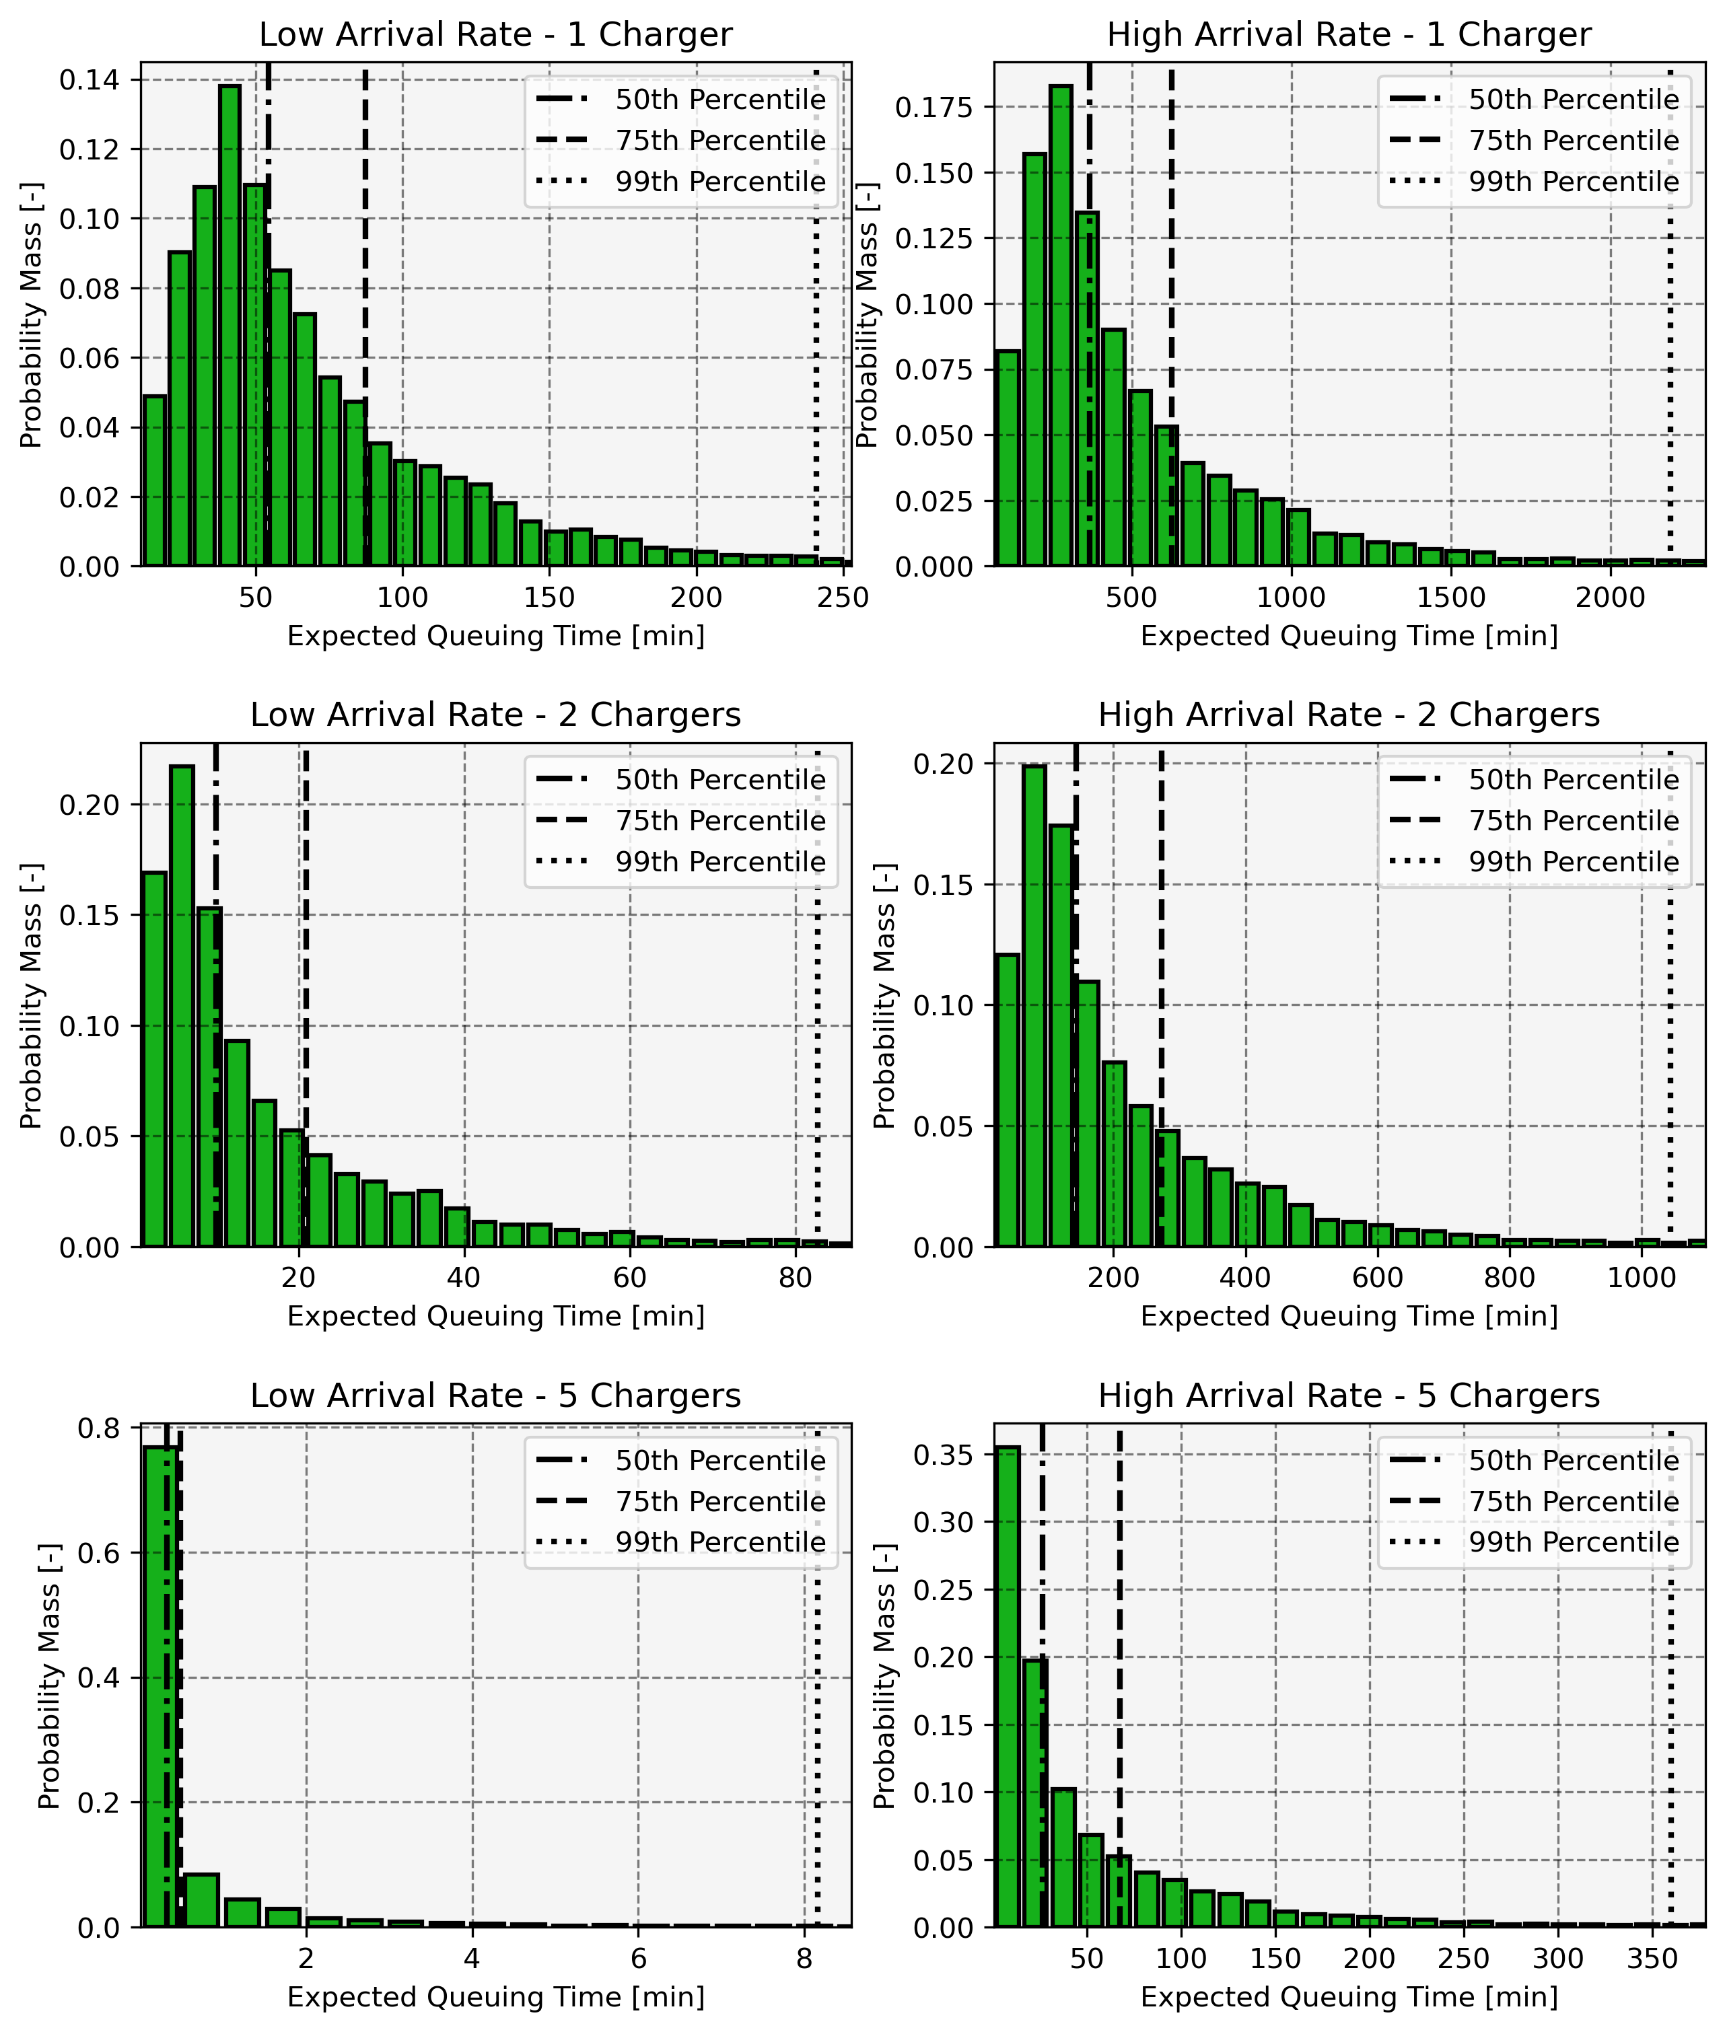
California’s DC Charger Networks
Queuing
Redundancy matters because it allows for demand to be spread among ports.
If demand exceeds redundancy a queue will form
The most important factor in reducing expected queue length is port redundancy
Redundancy in-station is different than between-station for two reasons:
Information: Little information is available about status of chargers that you can’t physically see
Latency: A charger in a different station which is free now might be occupied by the time you drive to it.

Slide 12

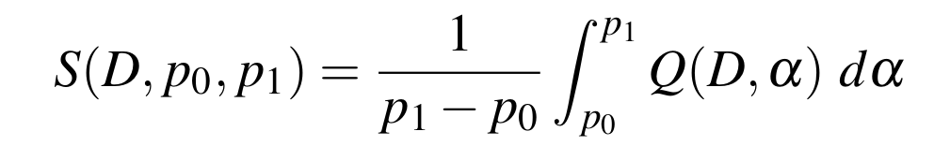
Driver Risk-Attitudes
Cautious decision-makers will focus on bad outcomes
Aggressive decision-makers will focus on good outcomes
Neutral decision-makers will weight all outcomes
We can represent this dynamic with the Superquantile Risk function which is used to inform optimal routing

Slide 13
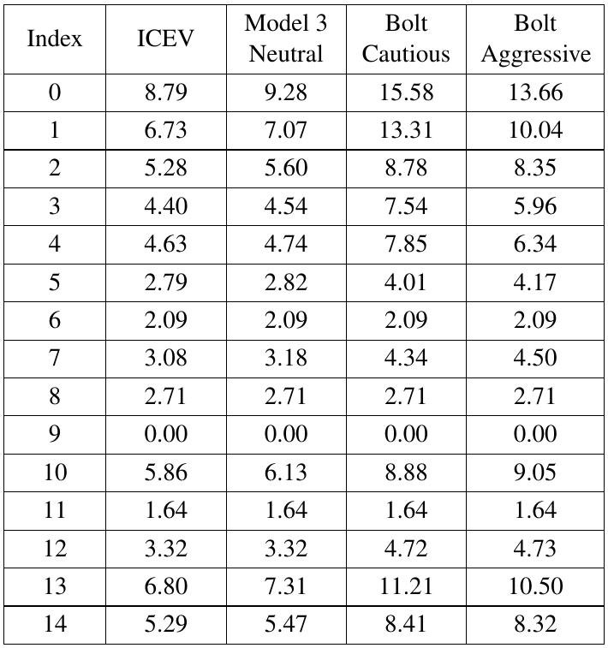
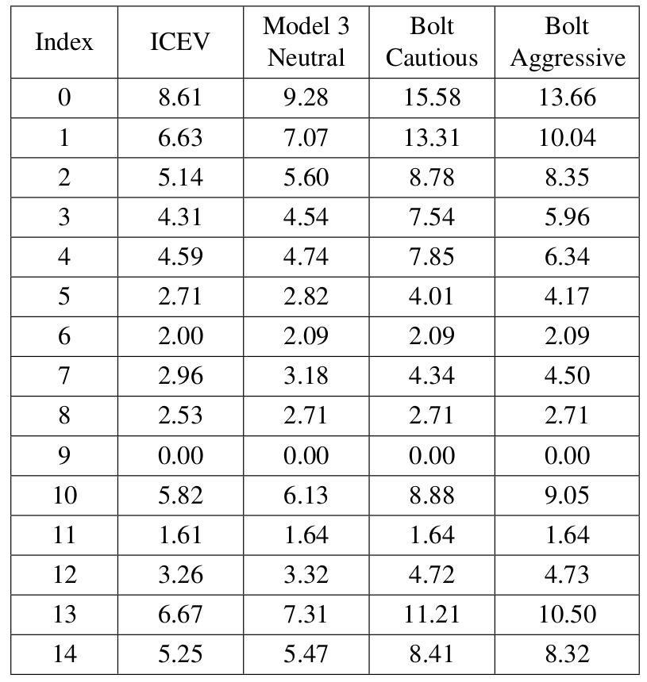
Specific Accessibility Example
Different Drivers from Fresno
Consider, as an example, the following four scenarios for a
driver based out of Fresno:
Risk neutral driver using a generic ICEV
Takes “direct path”
Risk neutral driver using a Tesla Model 3
High range
High charger reliability
Risk-cautious driver using a Chevrolet Bolt EV
Low range
Low charger reliability
Risk-aggressive driver using a Chevrolet Bolt EV
Low range
Low charger reliability
Hours to traverse arcs

Slide 14
Specific Accessibility Example
Different Drivers from Fresno
Little difference on short arcs
Major difference on long arcs
Hours to traverse arcs

Slide 15
General Accessibility Study
Experimental Design
How easy are BEV long trips in California? A full-factorial study was conducted on the following parameters:
Vehicle range - [200 miles, 300 miles, 400 miles] - (maximum charging speeds scale with capacity)
Charger network access - [Tesla, Non-Tesla, Combined]
Charger equipment reliability - [50%, 75%, 99%]
Driver risk-attitude - [Cautious (worst 50% of outcomes), Neutral (all outcomes), Aggressive (best 50% of outcomes)]
State-wide Road-Trip Accessibility was computed for each case

Slide 16
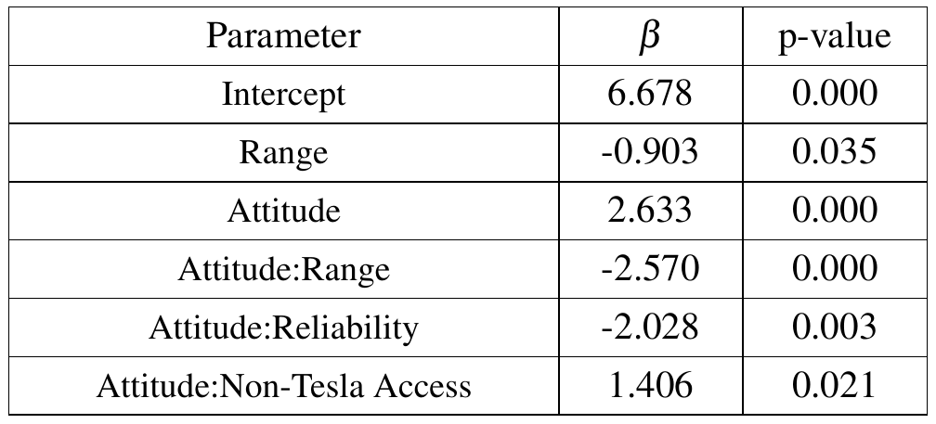
General Accessibility Study
Regression Results
Linear Regression based on Road-Trip Accessibility metric produced the following significant terms:

Slide 17
General Accessibility Study
Regression Results
Linear Regression based on Road-Trip Accessibility metric produced the following significant terms:
All else being equal, BEV travel takes more time than ICEV travel

Slide 18
General Accessibility Study
Regression Results
Linear Regression based on Road-Trip Accessibility metric produced the following significant terms:
Increasing range can often mean dropping one charging event

Slide 19
General Accessibility Study
Regression Results
Linear Regression based on Road-Trip Accessibility metric produced the following significant terms:
More cautious decision-makers will be put off by the immature DC charging network, especially in the more rural areas of the state. Better vehicles and networks can help alleviate this.

Slide 20
General Accessibility Study
Regression Results
Linear Regression based on Road-Trip Accessibility metric produced the following significant terms:
Tesla’s DC charging network provides the best redundancy and this matters to more cautious drivers.

Slide 21
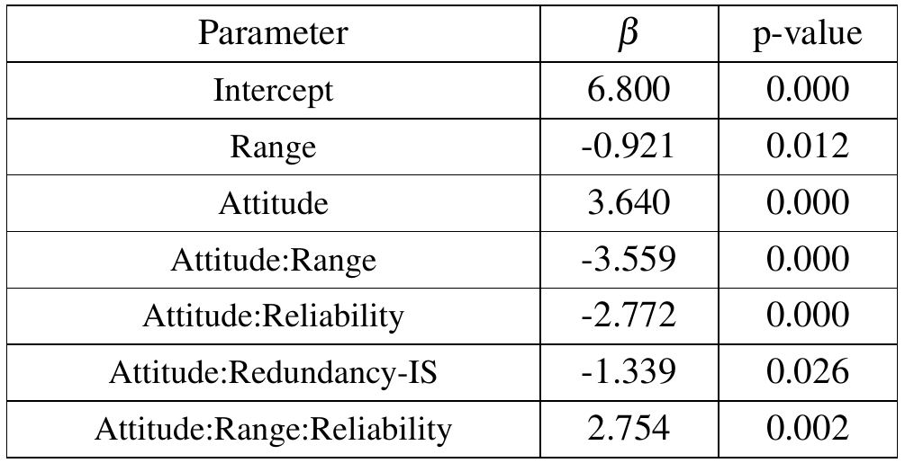
General Accessibility Study
Regression Results
Changing the regressors to include Redundancy In-Station and Between-Station directly
Redundancy In-Station is significant but Redundancy Between-Station is not

Slide 22
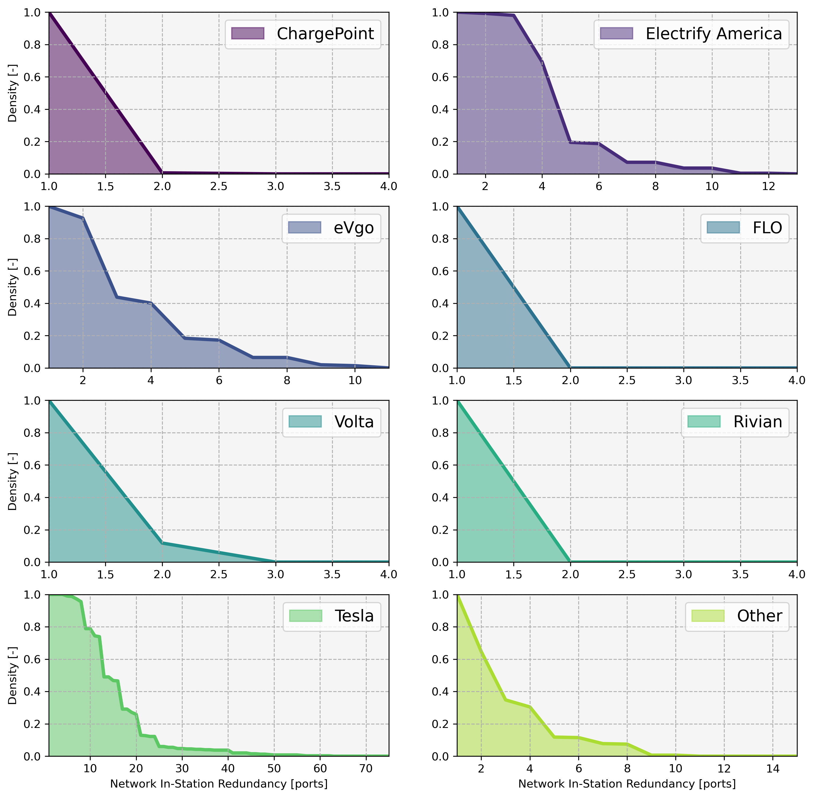
Conclusions
DC charging is needed to enable long road-trips for BEVs
People tend to over-weigh long trips in purchasing decisions compared to their frequency
In the US, a mode switch will usually be to a higher emission mode
DC charging networks are not yet mature
Speeds and redundancy need to improve to approach ICEV parity
At the moment information and latency issues make concentrated networks more beneficial for long road-trip travel
Tesla’s network is currently the most useful - might be a good model
Generally better utilization and reliability data will enable better analysis and better operation

Slide 23

Q & A

